Slide 1
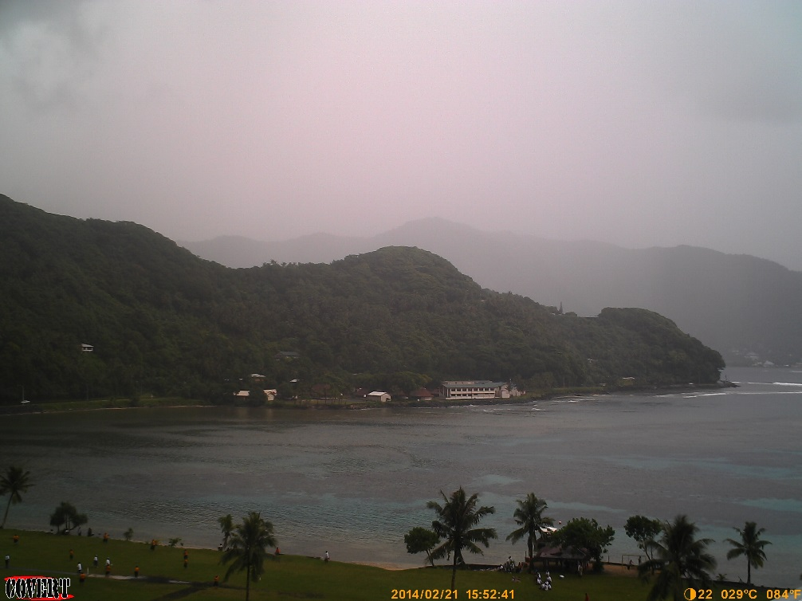
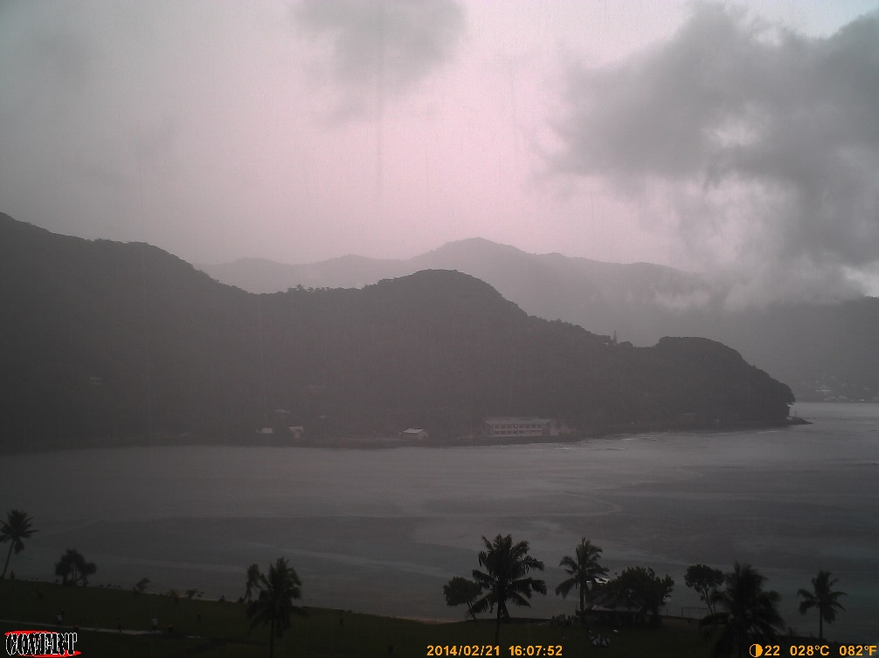
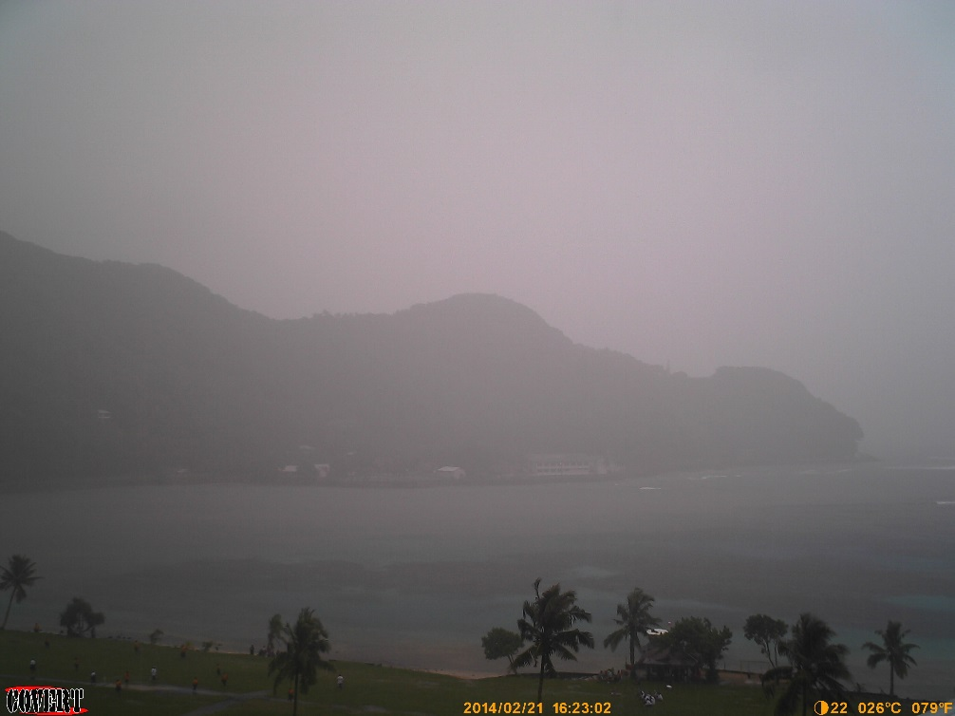
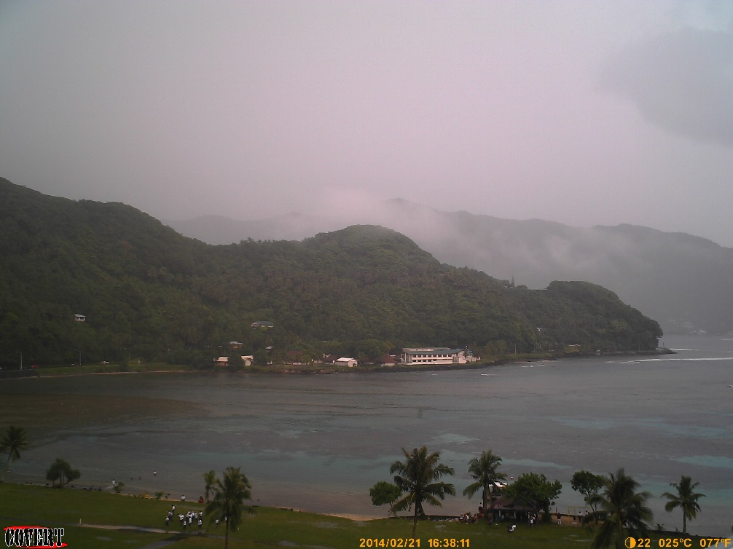
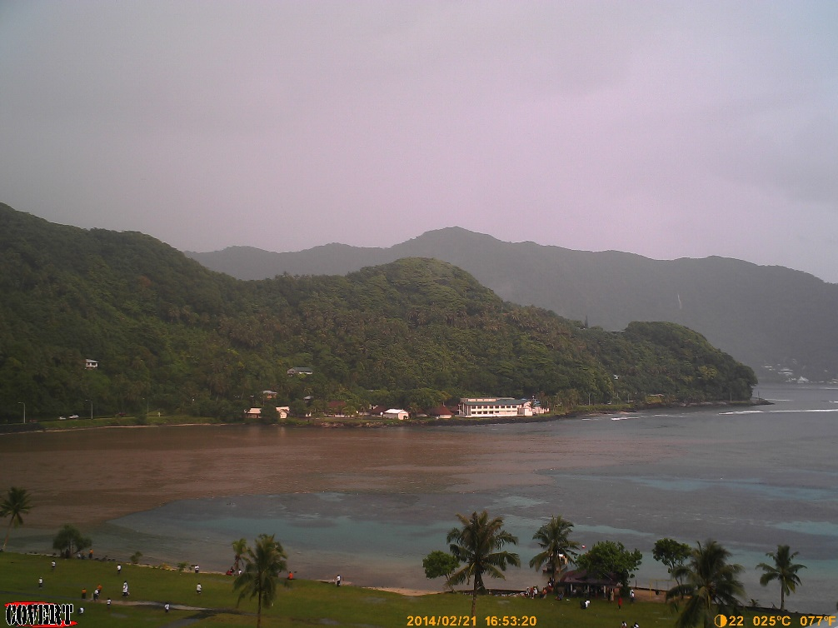
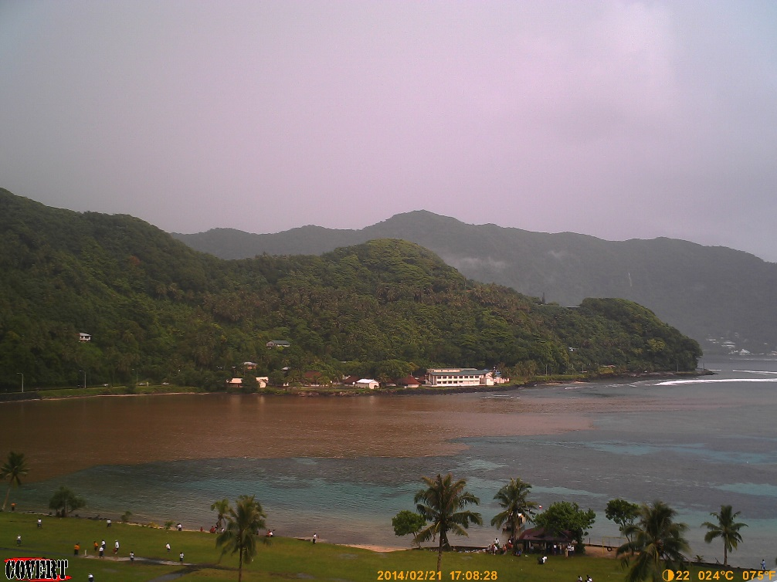
Faga’alu Bay: Sediment plume following large rain 2/21/14
1
2
3
15:52
16:07
16:23
4
5
6
16:38
16:53
17:08

Slide 2
Faga’alu Bay: Sediment plume following large rain 2/21/14
1
2
3
15:45
16:00
16:15
4
5
6
16:30
16:45
17:00

Slide 3
Fagáalu Bay: Sediment plume following large rain 2/21/14
a)
b)
c)
North Reef
Stream
South Reef
Channel
15:45
16:00
16:15
d)
e)
f)
Sediment plume deflected over North reef and Channel
16:30
16:45
17:00

Slide 4
Fagáalu Bay: Sediment plume following large rain 2/21/14
b)
c)
d)
North Reef
Stream
South Reef
Channel
15:45
16:00
16:15
e)
f)
g)
Sediment plume deflected over North reef and Channel
16:30
16:45
17:00

